Slide 1
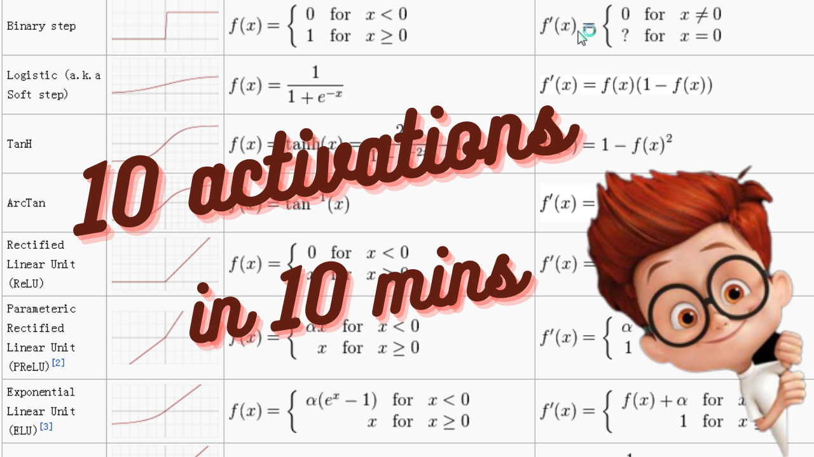

Slide 2
Functions Covered
Step
Sigmoid
Tanh
ReLU
Softplus
Maxout
GeLU
Swish
Mish
Softmax

Slide 3
Topics Covered
Motivation
Definition
Graph
Derivative
Properties
Performance
Use cases

Slide 4
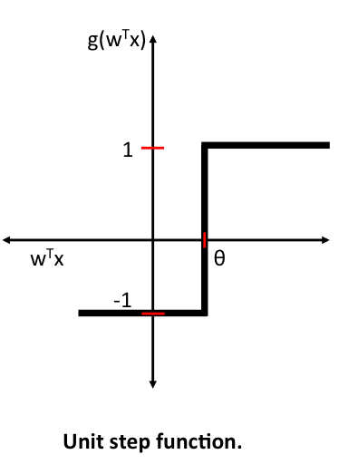
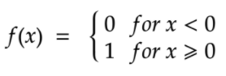

Step Activation Function
Motivation: Neurons firing in Human brain
Definition:
Derivative:
Properties:
Not-continuous
Bounded
Not 0-centered
Performance: Poor
Use case: Hidden & Output layers

Slide 5

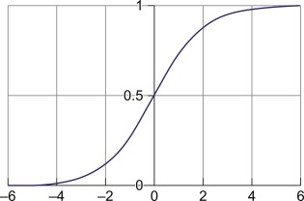
Sigmoid Activation Function
Motivation: Smooth curve and probabilistic output
Definition:
Derivative:
Properties:
Continuous
Non-linear
Monotonic
Bounded
Not 0-centered
Performance: Avg
Use Case: hidden & output layers

Slide 6
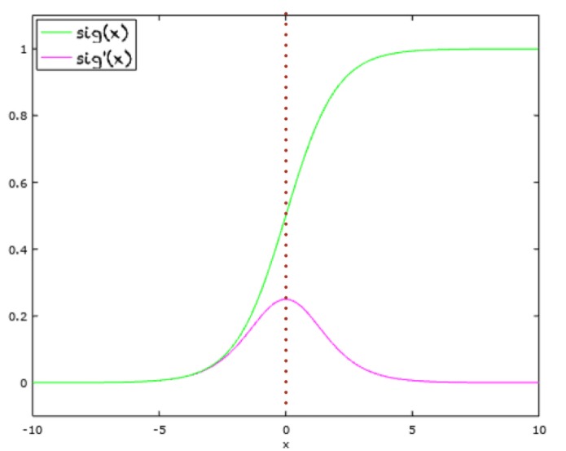
Vanishing Gradient

Slide 7

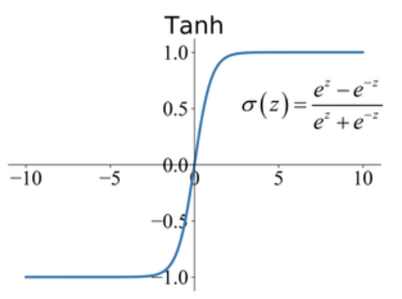

Tanh Activation Function
Motivation: Smooth curve and probabilistic output, 0-centered function
Definition:
Derivative:
Properties:
Continuous
Non-linear
Monotonic
Bounded
0-centered
Performance: Better than sigmoid
Use Case: hidden layers

Slide 8
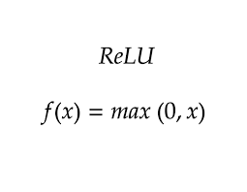
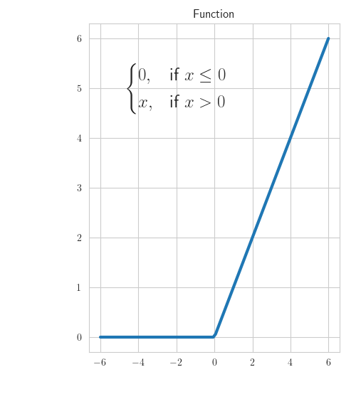
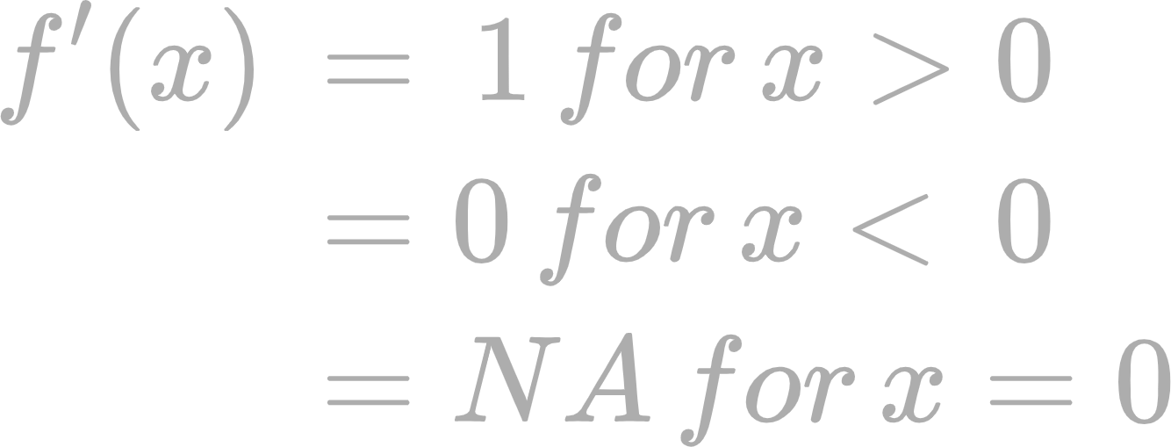
ReLU Activation Function
Motivation: Solve vanishing gradient problem, linear-like function
Definition:
Derivative:
Properties:
Not-Continuous
Piecewise linear
Monotonic
UnBounded
Not 0-centered
Performance: Better than sigmoid, tanh
Use Case: hidden layers

Slide 9
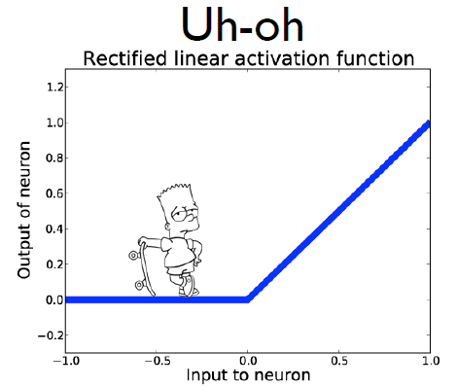
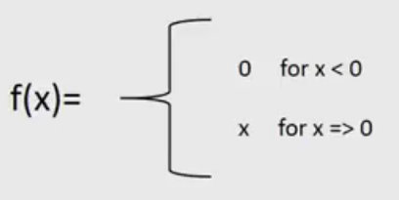
Dead Neurons

Slide 10

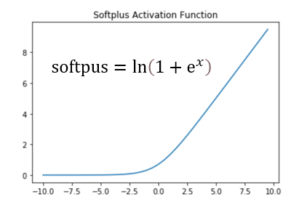
Softplus Activation Function
Motivation: ReLU-like function but smooth curve
Definition:
Derivative:
Properties:
Continuous
Non-Linear
Monotonic
UnBounded
Not 0-centered
Performance: Same as relu, but unstable
Use Case: hidden layers

Slide 11

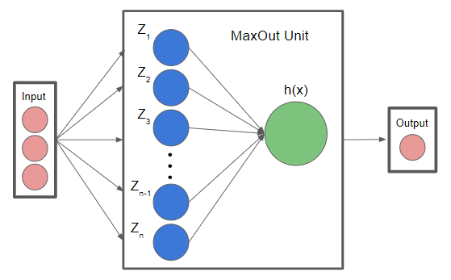
Maxout Activation Function
Motivation: Solve dead neurons issue
Definition:
Derivative: 1 or -1
Properties:
Not-Continuous
Piecewise-Linear
UnBounded
0-centered
Performance: Better than relu, but complex
Use Case: hidden layers

Slide 12
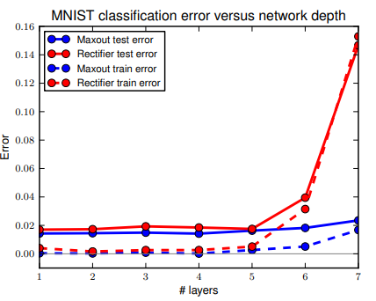
Maxout Activation

Slide 13

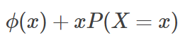
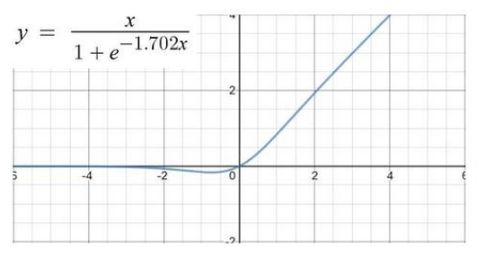
GeLU Activation Function
Motivation: Combine ReLU & Dropout
Definition:
Derivative:
Properties:
Continuous
Non-Linear
UnBounded
0-centered
Non-monotonic
Performance: Better than relu, Complex
Use Case: hidden layers

Slide 14
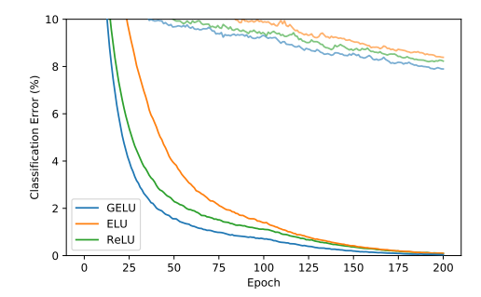
GeLU Activation
CIFAR-10

Slide 15

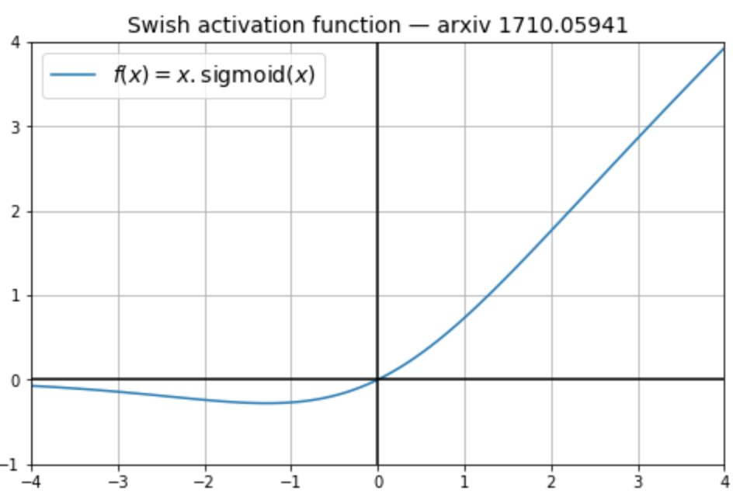

Swish Activation Function
Motivation: Search for better activation using NAS
Definition:
Derivative:
Properties:
Continuous
Non-Linear
Non-monotonic
UnBounded
0-centered
Performance: Better than relu
Use Case: hidden layers

Slide 16
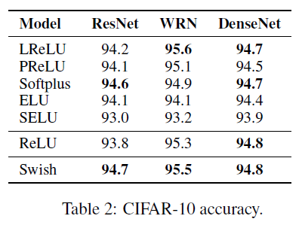
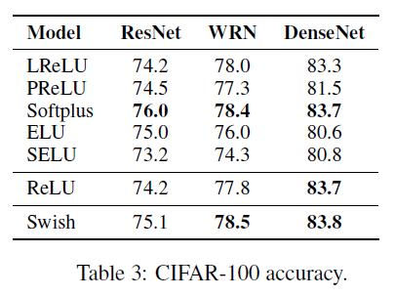
Image Classification

Slide 17

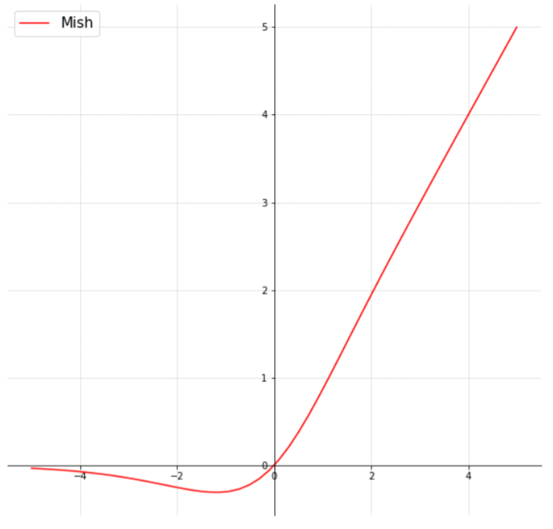
Mish Activation Function
Motivation: Inspired by Swish
Definition:
Derivative:
Properties:
Continuous
Non-Linear
Non-monotonic
UnBounded
0-centered
Performance: Better than relu & swish
Use Case: hidden layers

Slide 18
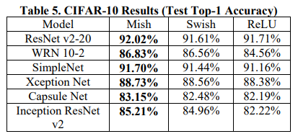
Performance

Slide 19
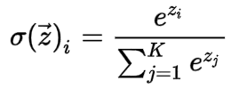
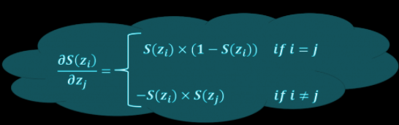
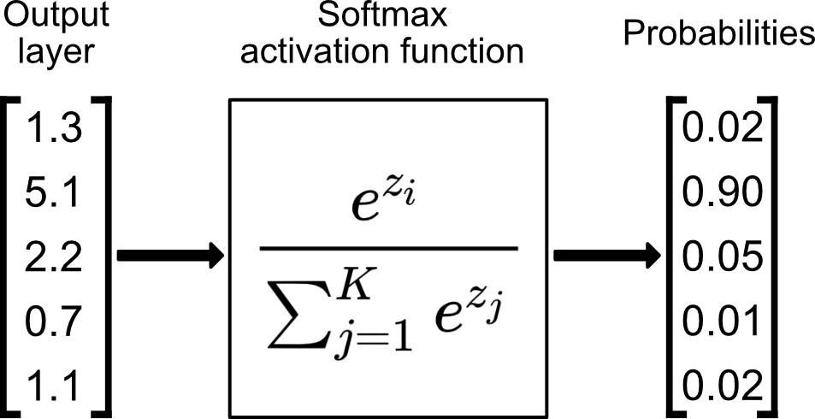
Softmax Activation Function
Motivation: Multiclass classification, probabilistic output
Definition:
Derivative:
Properties:
Non-Linear
Bounded
Not 0-centered
Performance: NA
Use Case: Output layers

